Slide 1


AI for Energy: Data-efficient and explainable algorithms to exploit energy flexibility
Chris Develder, et al. AI4E Team, IDLab, Ghent University – imec

Slide 2

Self-Introduction – Chris Develder^{[1]}
Professor at UGent since Oct. 2007
Research Interests: - AI4E Team: Artificial intelligence for energy applications^{[2]}: data analysis & machine learning for the energy transition - T2K Team: Natural language processing (NLP)^{[3]}: information extraction (IE), conversational agents, etc. - Past: track record in dimensioning and optimizing optical networks
Visiting researcher at UC Davis, CA, USA, Jul-Oct. 2007 (optical networks)
Visiting researcher at Columbia Univ., NY, USA, 2013-15 (IE & information retrieval)
Industry Experience: Network planning/design tools
Former OPNET Technologies, 2004-2005
PhD in optical networking, UGent, 1999-2003
[1] http://users.ugent.be/~cdvelder/
[2] https://ugentai4e.github.io/
[3] https://ugentt2k.github.io/

Slide 3
AI for Energy: Data-efficient and explainable algorithms to exploit energy flexibility
Chris Develder, et al. AI4E Team, IDLab, Ghent University – imec

Slide 4
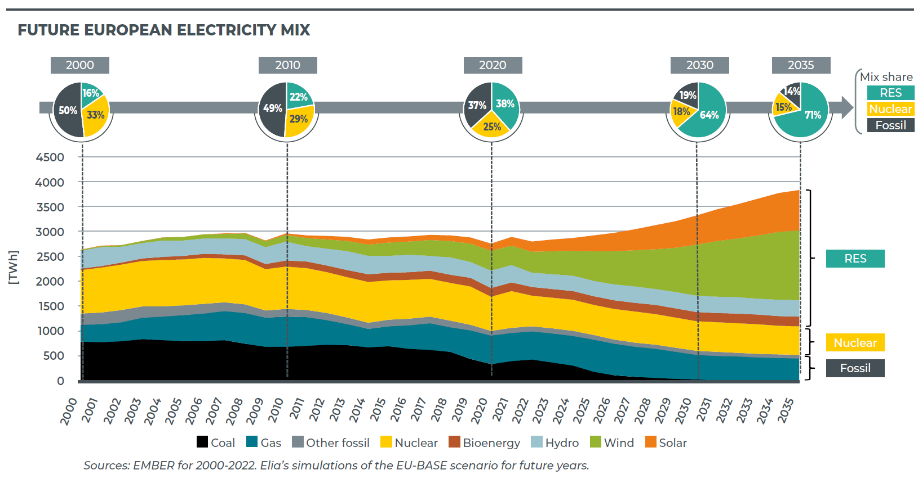
Energy Transition – Supply
~ 6% share of
Wind and Solar
Increased to
~ 28% in 2020
Expected to reach
~ 45% by 2035
Source: Adequacy & flexibility study for Belgium (2024-2034), ELIA

Slide 5
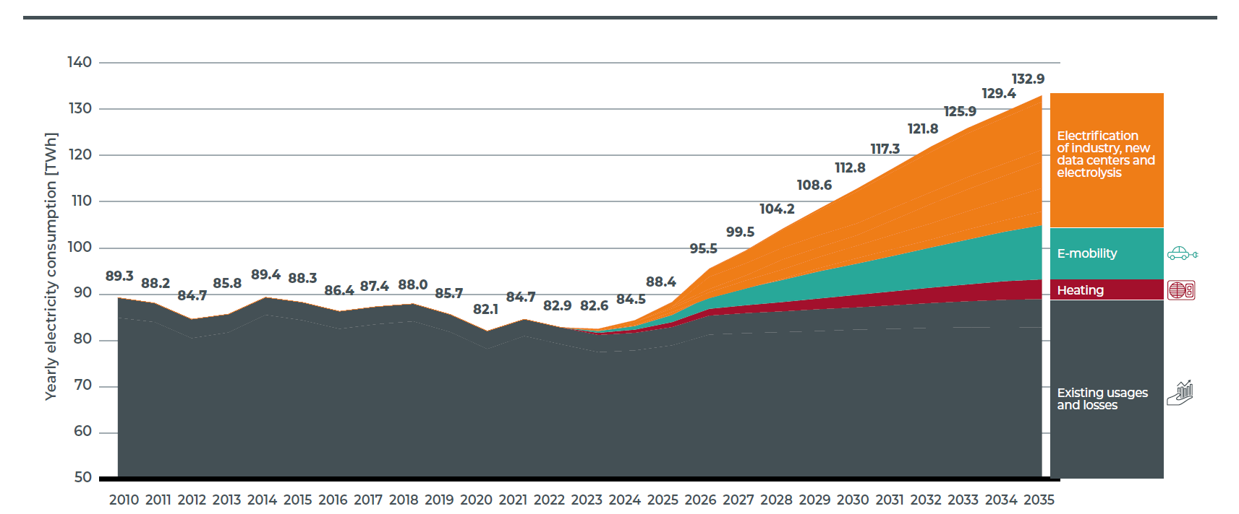
Energy Transition – Demand
~ 6% share of
EVs and Heating
Expected to reach ~ 25%
Source: Adequacy & flexibility study for Belgium (2024-2034), ELIA

Slide 6
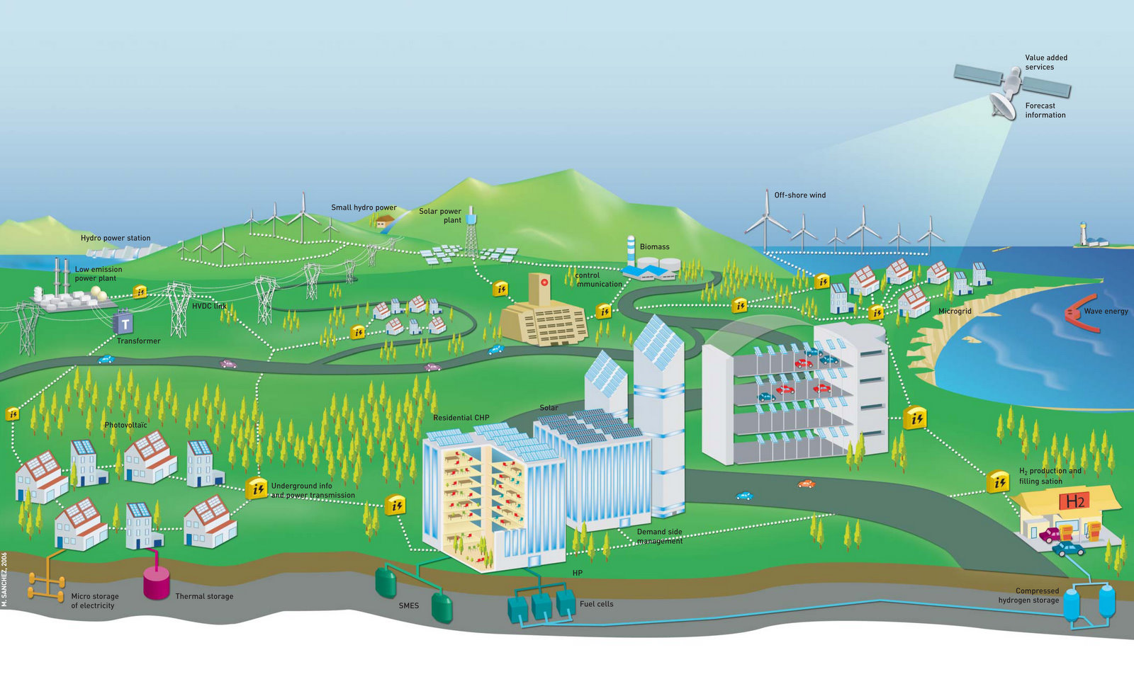

SMART GRID
Fault detection? Restoration? Data processing?
Privacy, security?
Pricing schemes?
. . .
New services & business models
Distributed generation (large scale)
Green energy sources (fluctuating)````````
ICT infrastructure
Demand side management
EV charging
(car parks)
Distributed generation
(small scale)
Heat pumps
EV charging
(residential)
Local energy storage
Notes:
Explain the changing power grid:
Distributed generation:
Small scale, local (residential, companies, etc.) & Large scale (e.g. offshore wind parks)
Problems associated with them: power quality (voltage, frequency instability…; phase balancing)
Integration of (electric) energy storage: cost, capacity, level
Electric Vehicles => Rising Energy demand
Smart Metering (technology that enables/stimulates many other smart grid applications)
Integration of ICT and Power Grids
Interoperability and openness of the smart grid
Autonomous services deployed as a cloud service (privacy)
Balancing
Illustrate the scale of both networks and how the size of them will explode the following years (kickoff for next slide)
Power: Resulting from electrification (e.g. vehicles)
ICT: Everything connected everywhere
Combination of both (new/existing electrical components that will become connected and intelligent)

Slide 7
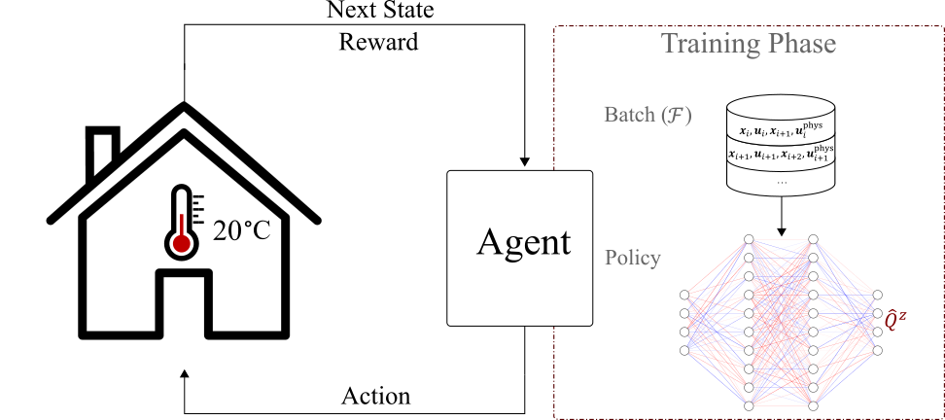
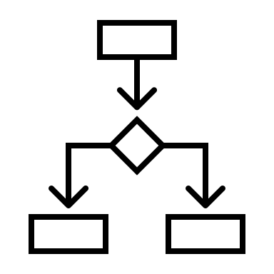

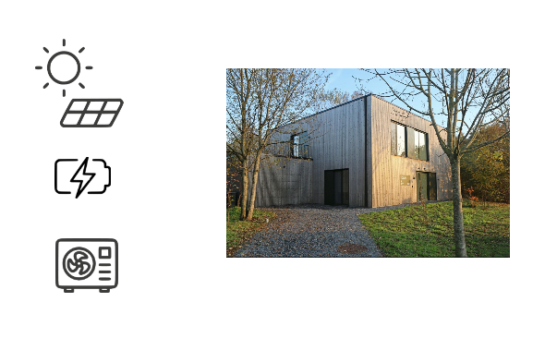
Outline
PART I: Physics-informed reinforcement learning
Challenge: Learn suitable control policy from limited data
Solution: Infuse a priori physics knowledge into neural network model
PART II: Interpretable decision trees
Challenge: Policies from RL are black-box and non-trivial to deploy
Solution: Distill a learned policy into decision tree
PART III: Real-world testbed environment
HomeLabGym: Standardized interface to experiment with real house
HomeLabGym
Notes:
Ne

Slide 8

PART I: Physics-informed reinforcement learning for residential heat pump control
G. Gokhale, B. Claessens, and C. Develder, ”Physics-informed neural networks for control-oriented thermal modeling of buildings”, Appl. Energy, Vol. 314, 15 May 2022, pp. 1-10. doi:10.1016/j.apenergy.2022.118852
G. Gokhale, B. Claessens, and C. Develder, ”PhysQ: A physics-informed reinforcement learning framework for building controls”, Arxiv preprint, 21 Nov. 2022, arXiv:2211.11830v1
Thanks
Gargya!

Slide 9
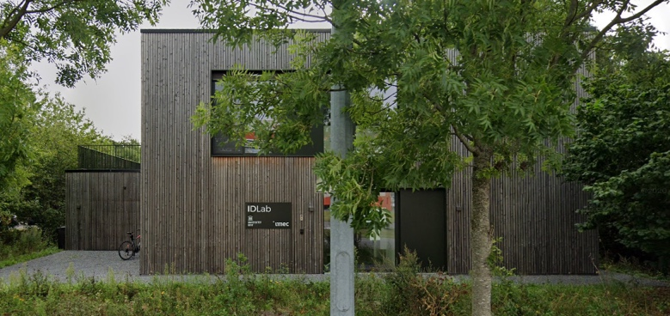
Residential heat pump control: Problem statement & proposed solution
Objective:
Minimize cost of energy consumed by a household while maintaining thermal comfort
Controller should:
Use data efficiently
Scale across different households
Yield high-quality control policies
Proposed Solution:
Off-policy reinforcement learning with physics informed neural networks

Slide 10


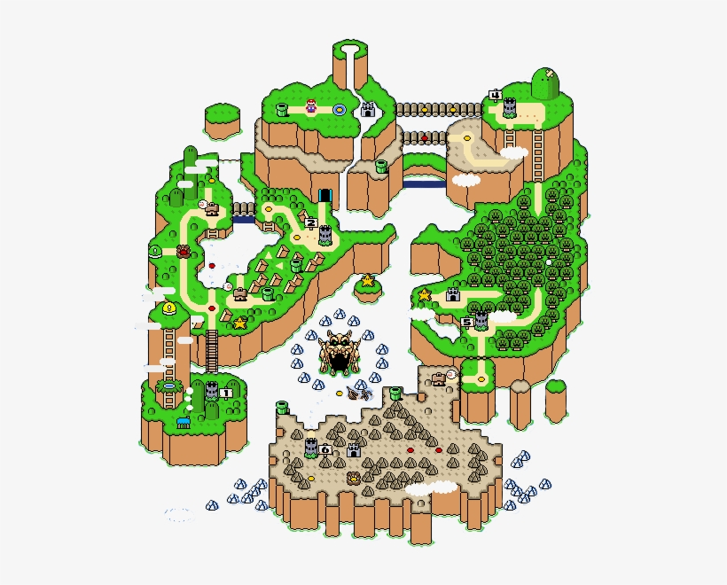
Reinforcement Learning: Agent acts in an environment
Action
At each timestep t the agent
Gets state observation s_{t}
Gets scalar reward r_{t} (depending on current state and thus previous action(s))
Decides to take action a_{t}
The environment
Receives action a_{t}
Emits state s_{t +1} (which will depend on action)
Emits scalar reward r_{t + 1}
RL idea: learn a policy that maps state s_{t} to action a_{t} , such that long-term reward ∑r_{t} is maximized
s_{t}
r_{t}
a_{t}
State
Reward

Slide 11
Reinforcement Learning: Agent acts in an environment
Action
HEM
controller
At each timestep t the agent
Gets state observation s_{t}
Gets scalar reward r_{t} (depending on current state and thus previous action(s))
Decides to take action a_{t}
The environment
Receives action a_{t}
Emits state s_{t +1} (which will depend on action)
Emits scalar reward r_{t + 1}
RL idea: learn a policy that maps state s_{t} to action a_{t} , such that long-term reward ∑r_{t} is maximized
s_{t}
r_{t}
€
a_{t}
State
Cost

Slide 12
Reinforcement Learning: Heat pump control
state
- outdoor T
- indoor T
- price
- time
action
HEM
controller
heat pump power

Slide 13
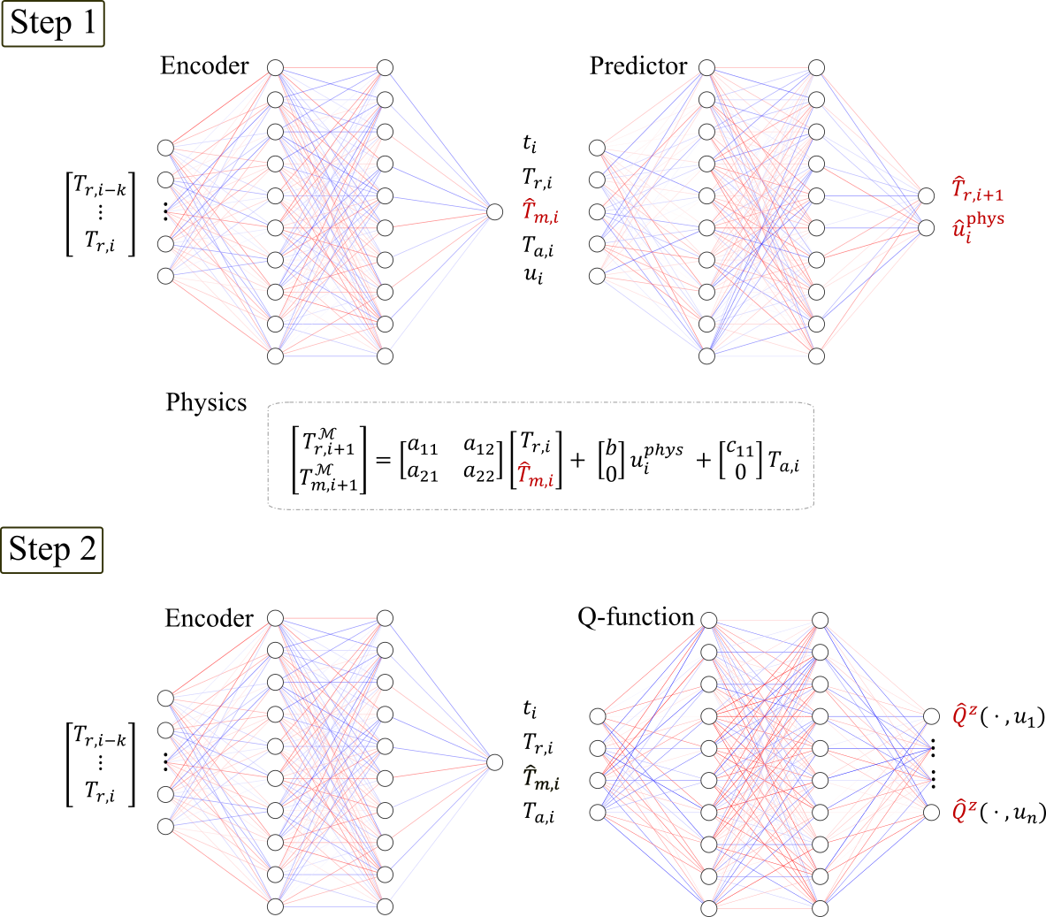
PhysQ: A physics-informed reinforcement learning framework
PhysQ:
Physics informed RL framework
Leverages prior physics to learn physically relevant latent representations
Learns a control policy using this latent representation
Two-step Algorithm:
Step 1: Learn physically relevant representation (bulk temperature T_{m}), from predicting state transitions
Step 2: Learn a low-dimensional Q-function based on this representation, to perform the actual control

Slide 14
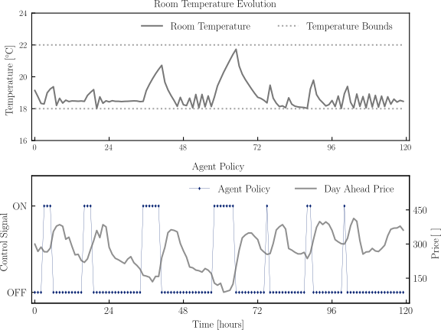
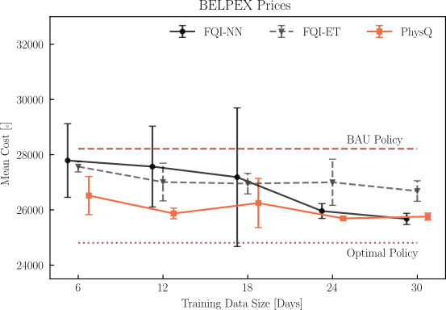
Simulation results
Results for BELPEX prices using a building simulator
Comparison over different training data sizes and agent types
Black box models
Heating at (relatively) low price points
On
Lower overall cost,
especially for low volumes of training data
Off

Slide 15
Simulation results
Results for BELPEX prices using a building simulator
Comparison over different training data sizes and agent types
Black box models
Heating at (relatively) low price points
On
Lower overall cost,
especially for low volumes of training data
Off

Slide 16
PART II: Interpretable decision trees distilled from black-box RL policies
G. Gokhale, S.S. Karimi Madahi, B. Claessens and C. Develder, "Distill2Explain: Differentiable decision trees for explainable reinforcement learning in energy application controllers", in Proc. 15th ACM Int. Conf. Future Energy Sys. (e-Energy 2024), Singapore, 4-7 Jun. 2024, pp. 1-8. doi:10.1145/3632775.3661937
Thanks
Gargya!

Slide 17
Black-box Reinforcement Learning
Black-box model: cannot explain why a given action is chosen . . .
state
action
- outdoor T
- indoor T
- time
- load
- PV power
- . . .
- heat pump power
- battery power
- . . .
HEM
controller

Slide 18
Black-box Reinforcement Learning
Idea: replace neural networks by something more explainable!
state
action
- outdoor T
- indoor T
- time
- load
- PV power
- . . .
- heat pump power
- battery power
- . . .
HEM
controller

Slide 19
Enhancing explainability: Differentiable Decision Trees
“If it is sunny and household load is low, then charge battery”
PV power > 0.47
PV power > 0.47
yes
no
Load > 0.68
Load > 0.68
PV power > 0.41
yes
no
yes
no
[0.385, 0.413, 0.076, 0.069, 0.057]
[0.060, 0.082, 0.304, 0.344, 0.210]
[0.060, 0.082, 0.304, 0.344, 0.210]
[0.077, 0.081, 0.418, 0.071, 0.353]
[0.378, 0.384, 0.087, 0.097, 0.053]
Discharge at 50% power
Charge at 50% power
Remain idle
Discharge at 50% power

Slide 20
Distill2Explain: Learns the tree from trained RL policy
Step 1: train an RL “teacher” model
Step 2: distill a decision tree “student” model
Action
€
State
Cost

Slide 21
Distill2Explain: Learns the tree from trained RL policy
Step 1: train an RL “teacher” model
Step 2: distill a decision tree “student” model
Action
How? E.g., see [1] on how to disill soft decision trees.
We learn deterministic trees
€
State
Cost
[1] Y. Coppens, K. Efthymiadis, T. Lenaerts, A. Nowé, T. Miller, R. Weber, and D. Magazzeni, “Distilling deep reinforcement learning policies in soft decision trees”, In Proc. IJCAI 2019 Workshop on Explainable AI, pp. 1–6.

Slide 22
Sample result: Home battery control under time-varying pricing
Household with rooftop PV and battery
Day-ahead pricing (qh based) and capacity tariff (= based on max. peak load)
Comparable cost . . .
DDT
depth 3
20
Baseline RBC
with simpler policies
15
Cost (€)
DDT
depth 2
10
5
DQN
DDT
depth 2
DDT
depth 3
DQN
DQN
DDT
depth 2
DDT
depth 3

Slide 23
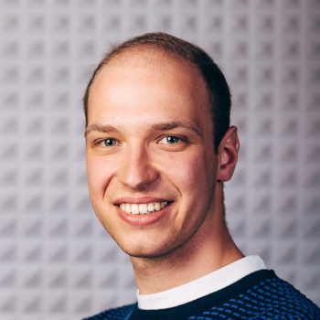
PART III: A real-world testbed environment: HomeLabGym
T. Van Puyvelde, M.-S. Verwee, G. Gokhale, M. Zareh Eshdoust and C. Develder, "HomeLabGym: A real-world testbed for home energy management systems", in Proc. 15th ACM Int. Conf. Future Energy Sys. (e-Energy 2024), Singapore, 4-7 Jun. 2024, pp. 1-2. doi:10.1145/3632775.3661974
Thanks
Toon!

Slide 24
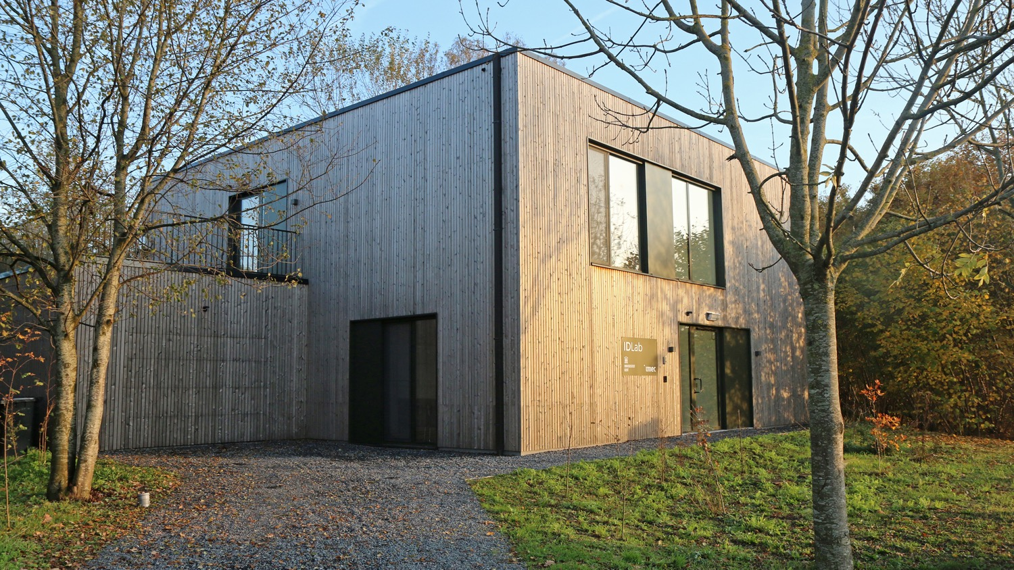






HomeLab
Research infrastructure to validate and optimize IoT & AI innovations in real environment
>300 sensors (temperature, energy, light, occupancy, …)
HVAC, ESS, PV
Controllable blinds and windows
. . .
Notes:
HomeLab is an initiative of imec and Ghent University. It is both a home and a lab as it is a two-story house in which people can live temporarily to test and co-create IoT prototypes or products. With technical corridors in every room and an open home automation system, it offers tremendous flexibility to develop and install early prototypes of smart products and test their interoperability with other systems.
It focuses on testing and co-developing smart home innovations in a variety of application domains – from home automation and (health)care to entertainment, energy and security. It aims at serving the needs of SMEs as well as large businesses, researchers, non-profit organizations, etc.
It is located on the Technology Campus Ghent in Belgium
www.imec-int.com/homelab

Slide 25
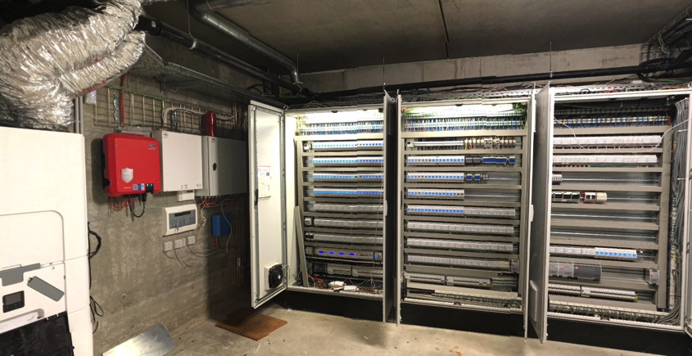
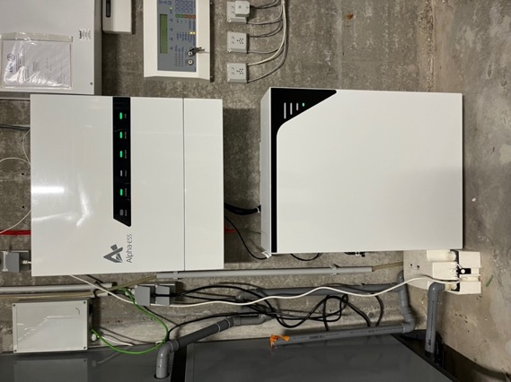
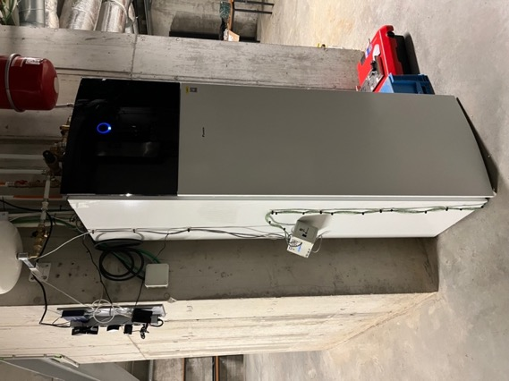


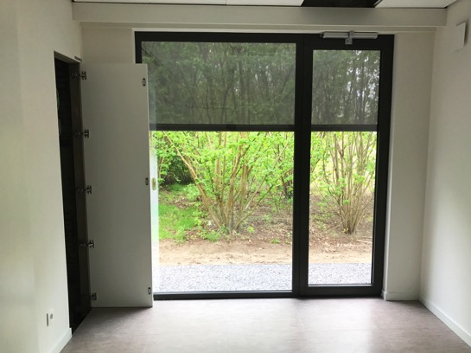
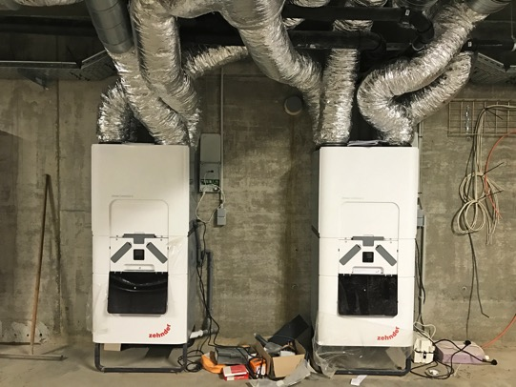
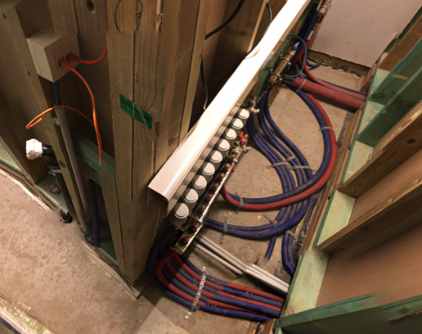
Energy consumption monitoring per wall socket and building system (> 150 measurement points)
Home battery
Collab w/
PhD funded by
5kWp solar panels
Controllable heat pump + low temperature radiators + controllable valves
2 ventilation systems with controllable valves to living room and meeting rooms
Controllable blinds & windows
Energy infrastructure
Notes:
The cellar holds the HVAC (heating, ventilation, and air conditioning) equipment (2 ventilation systems with top cooling + heat pump), and the extended electrical cabinets . On the roof 5kWp solar panels are installed
HomeLab features an open home automation system (Velbus) able to control and monitor all functional elements (screens, switches, doors, windows, etc.) in the house.
Multiple vendor systems can be installed simultaneously in order to validate or benchmark building automation components or services.

Slide 26
HomeLabGym
?
action
Controller
next state,
reward
Focus of our research: controllers, based on reinforcement learning, to exploit energy flexibility

Slide 27
HomeLabGym
Wishlist:
Standardized approach
Plug-and-play
Extensible solution
Broad range of communication protocols
. . .
action
Controller
next state,
reward

Slide 28

HomeLabGym
PV
action
Modbus, API, TCP/IP
Docker, Grafana
Controller
HomeLabGym
Battery
Heat Pump
next state,
reward
. . .
Standardized interface, used for many RL benchmarks (cf. OpenAI gym environments)

Slide 29
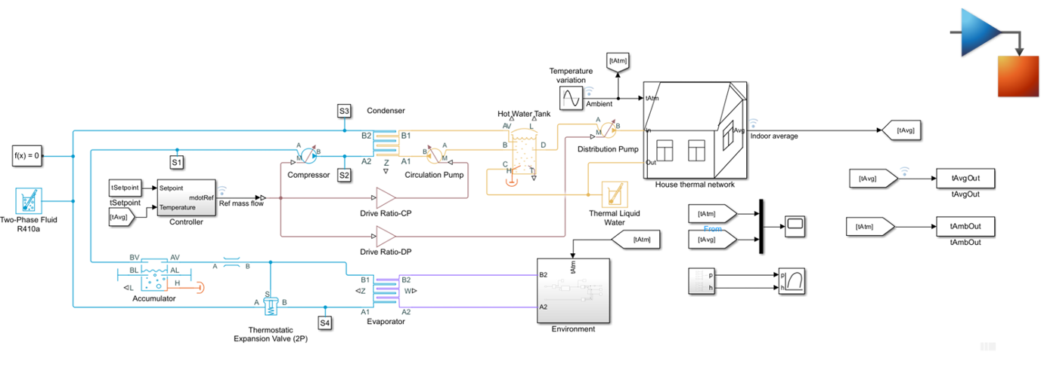
HomeLabGym
PV
Modbus, API, TCP/IP
Docker, Grafana
HomeLabGym
Battery
Heat Pump
action
Controller
. . .
next state,
reward
HomeSimGym
(Matlab engine)

Slide 30
HomeLabGym
PV
Modbus, API, TCP/IP
Docker, Grafana
HomeLabGym
Battery
Heat Pump
action
Controller
. . .
next state,
reward
HomeSimGym
(Matlab engine)

Slide 31

Example use case for HomeLabGym: Validation of RL for energy arbitrage
S.S. Karimi Madahi, G. Gokhale, M.-S. Verwee, B. Claessens and C. Develder, "Control policy correction framework for reinforcement learning-based energy arbitrage strategies", in Proc. 15th ACM Int. Conf. Future Energy Sys. (e-Energy 2024), Singapore, 4-7 Jun. 2024, pp. 1-9.. doi:10.1145/3632775.3661948
Case study:
Home battery
Time-varying prices (qh-based)
Distributional DQN strategy accounting
Validation of simulation
Real-world battery
Using HomeLabGym
Results
Latency in communication (~10s)
Battery efficiency affected by temperature
Effect on daily revenue: real profit €5.6 vs. simulated €6
Thanks
Soroush!

Slide 32


Thank you! Any questions?
It’s not easy
being green …
chris.develder@ugent.be
http://users.ugent.be/~cdvelder

Slide 33




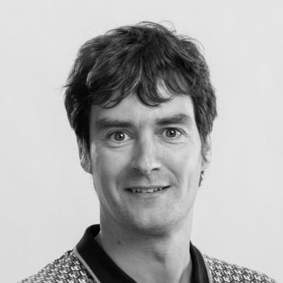




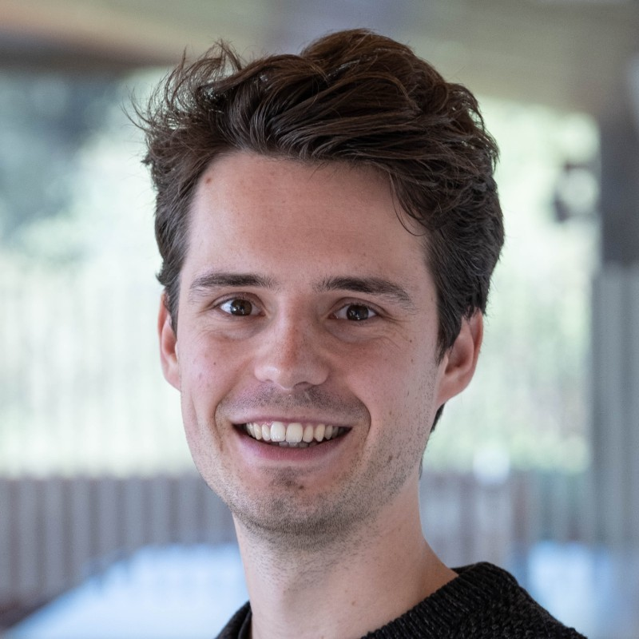


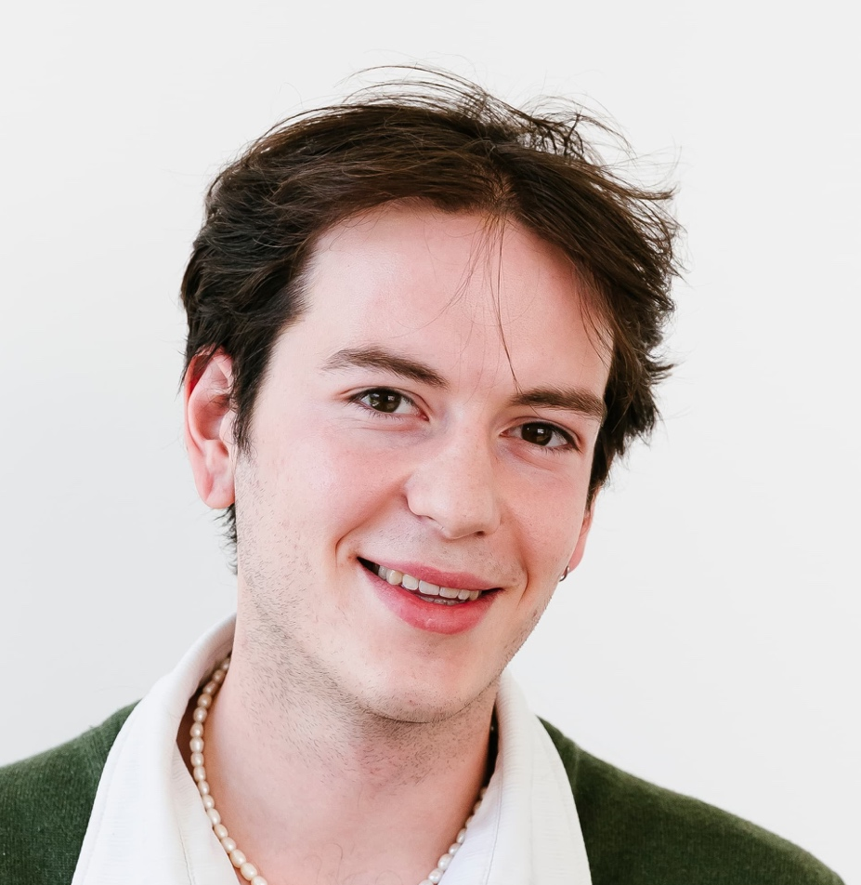
The AI4E team at IDLab, Ghent University
https://ugentai4e.github.io/

Slide 34
TEAM
Prof. (team leaders)
Postdoc
PhD student

Slide 35
AI4E: DATA-DRIVEN SOLUTIONS
Data-efficient
Control
Scalable Flexibility Exploitation
Predictive Support Tools

Slide 36
RESEARCH TRACKS
Data-driven decision making for . . .
Home Energy Management (HEM)
Value stacking (capacity tariff / dynamic pricing / ...)
Heterogeneous households (Heat pump / EV / Home battery / Thermal Storage)
Real/short-time (24h down to 1s) flexibility optimization
Multi-market day-ahead and real-time trading in energy and flexibility markets (EU/UK)
Multi-asset flexibility coordination, focusing on residential flexibility
Support tools for power system operators
Decision support for consumer-centric market vision (Imbalance forecasting; RTP price calculations; digital twins …)
State estimation and forecasting (DSO/TSO)

Slide 37
TECHNOLOGY
Creating scalable / practical / intuitive / performant AI that is . . .
fit-for-purpose (provide a solution, not a method)
a holistic solution, not just an optimizer (incl. technical/regulatory/legal/... constraints)
Focusing on
Neural network architectures, e.g.:
Physics-informed neural networks and transfer learning: obtain practical and intuitive (explainable) solutions
Graph Neural Networks (natural fit with power systems): trading / grid solutions / agent interactions
Architectures that can handle long time series (e.g., transformers)
Data-driven decision making
Blending rule-based (apprentice learning) / model-based (MPC) / model-free (Reinforcement Learning)
Transfer learning and multi-agent decision making

Slide 38

AI4E TEAM – Embedding in FLANDERS
Aligned within EnergyVille research; e.g., joint projects:
Vlaio cSBO project: DAPPER (Sep ’20 – Aug ’23; with imec, KULeuven, UHasselt)
Vlaio cSBO projects: InduFlexControl 1 & 2 (Sep ’22 – Feb ’25; with Vito, KULeuven)
Flux50 ICON project: DITUR (Mar ’20 – Aug ’21; with Vito, KULeuven, UHasselt)
Part of UGent EnerGhentIC consortium (= interdisciplinary energy research community of UGent); e.g.,
Horizon 2020 project RENergetic (Nov ’20 – Oct ’24; w/ Faculty of Law & Criminology, i.a.)
Fully funded PhD from Daikin at AI4E (part of bigger UGent-Daikin framework; started Oct. ’23)

Slide 39
AI4E TEAM – SCIENTIFIC PUBLICATIONS
See the “Publications” section of http://users.ugent.be/~cdvelder or https://ugentai4e.github.io/
Team lead Chris Develder has (co-)authored 75+ international journal papers, and 185+ conference papers. According to google scholar he has an h-index of 43
Recent key publications on AI for energy: *
N. Sadeghianpourhamami, N. Refa, M. Strobbe, and C. Develder, “Quantitive analysis of electric vehicle flexibility: A data-driven approach”, Int. J. Electr. Power Energy Syst., Vol. 95, Feb. 2018, pp. 451-462. [impact factor 2021: 5.659; times cited: 218]
K. Mets, F. Depuydt and C. Develder, “Two-stage load pattern clustering using fast wavelet transformation”, IEEE Trans. Smart Grid, Vol. 7, No. 5, Sep. 2016, pp. 2250-2259. [impact factor 2021: 10.275; times cited: 87]
L. De Baets, J. Ruyssinck, C. Develder, T. Dhaene, and D. Deschrijver, “Appliance classification using VI trajectories and convolutional neural networks”, Energy Build., Vol. 158, Jan. 2018, pp. 32-36. [impact factor 2021: 7.201; times cited: 237]
K. Mets, J. Aparicio, and C. Develder, “Combining power and communication network simulation for cost-effective smart grid analysis”, IEEE Commun. Surv. Tutor., Vol. 16, No. 3, Jul. 2014, pp. 1771-1796. [impact factor 2021: 33.840; times cited: 291]
J. Van Gompel, D. Spina, and C. Develder, “Satellite-based fault diagnosis of photovoltaic systems using recurrent neural networks”, Appl. Energy, Vol. 305, Jan. 2022, pp. 1-12. [impact factor 2021: 11.446; times cited: 57]
* : Times cited according to Google (as of Oct. 28, 2024); Impact factor according to Clarivate JCR

Slide 40
Thank you! Any questions?
It’s not easy
being green …
chris.develder@ugent.be
http://users.ugent.be/~cdvelder

